Slide 1

GROUP PROJECT
American university of University
Introduction to Computer Science

Slide 2




QuizBrains
Flashcards & Quiz Generator
CREATE
TRACK PROGRESS
PRACTICE

Slide 3

OURTEAM:
Mane Karapetyan
Nelli Poghosyan
Rozeta Gevorgyan
Date:
07.12.2025

Slide 4




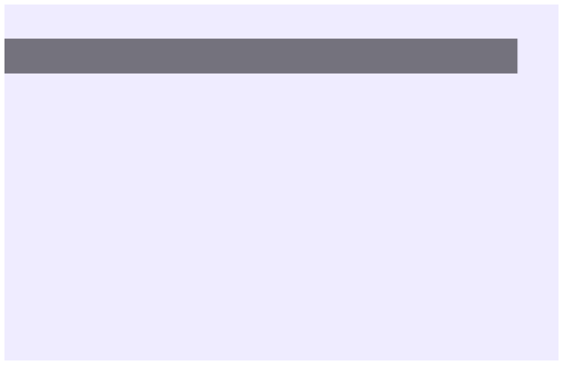
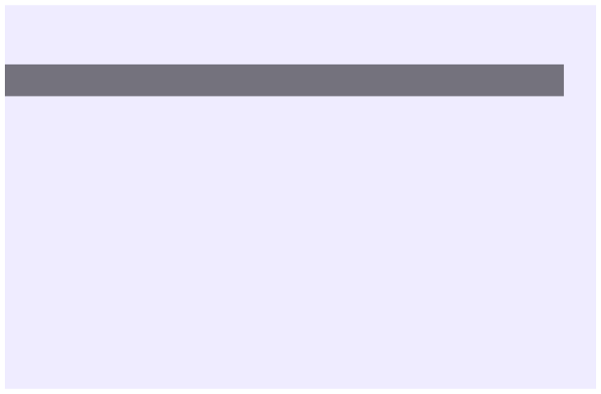

PROJECT OVERVIEW
A text-based flashcard and quiz system that allows users to create and study their own personalized flashcards.
CREATE & MANAGE
add_flashcard(flashcards) def add_flashcard(flashcards): # Input term and definition # Handles duplicates with overwrite option
edit_flashcard(flashcards( def edit_flashcard(flashcards): # Update definition for existing term
PURPOSE:
PURPOSE:
Updates the definition of an existing flashcard by term. Validates that the term exists and that the new definition is not empty.
Adds new flashcards with input validation. Checks for duplicates and prompts user to overwrite if term exists. Automatically saves after adding.

Slide 5

delete_flashcard(flashcards)
list_flashcards(flashcards)
def list_flashcards(flashcards): #Prints numbers list of all cards
def delete_flashcards(flashcards): #Remove flashcard by term
PURPOSE:
PURPOSE:
Displays all flashcards in a numbered list format showing term and definition. Hnadles empty flashcard collections gracefully.
Deletes a flashcard from the dictionary by term name. Validates input and checks if the term exists before deletion
KEY FEATURES: All operations validate input (empty checks)
User action trigger save_flashcards() for data persistance Duplicate detection with overwrite option Error messages for invalid operations

Slide 6

loading_flashcards()
save_flashcards(dict)
def loading_flashcards():
def save_flashcards(flashcards):
#Returns dict {term: definition}
#Writes to data/flashcards.txt
PURPOSE: Reads flashcards from data/flashcards.txt and returns a dictionary. Handles missing files and malformed lines safely.
PURPOSE: Saves the flashcards dictionary to data/ flashcards.txt. Auto-creates the data folder if missing.
save_quiz_result(score, total)
show_quiz_result():
def save_quiz_result(score, total):
def show_quiz_result():
#Appends: score/total | % | timestamp
# Prints numbered quiz history
l
PURPOSE:
Appends quiz results to data/quiz_stats.txt with
score, percentage and timestamp for progress
tracking.
PURPOSE:
Reads and displays all quiz attempts from data quiz_stats.txt in a numbered list format.

Slide 7


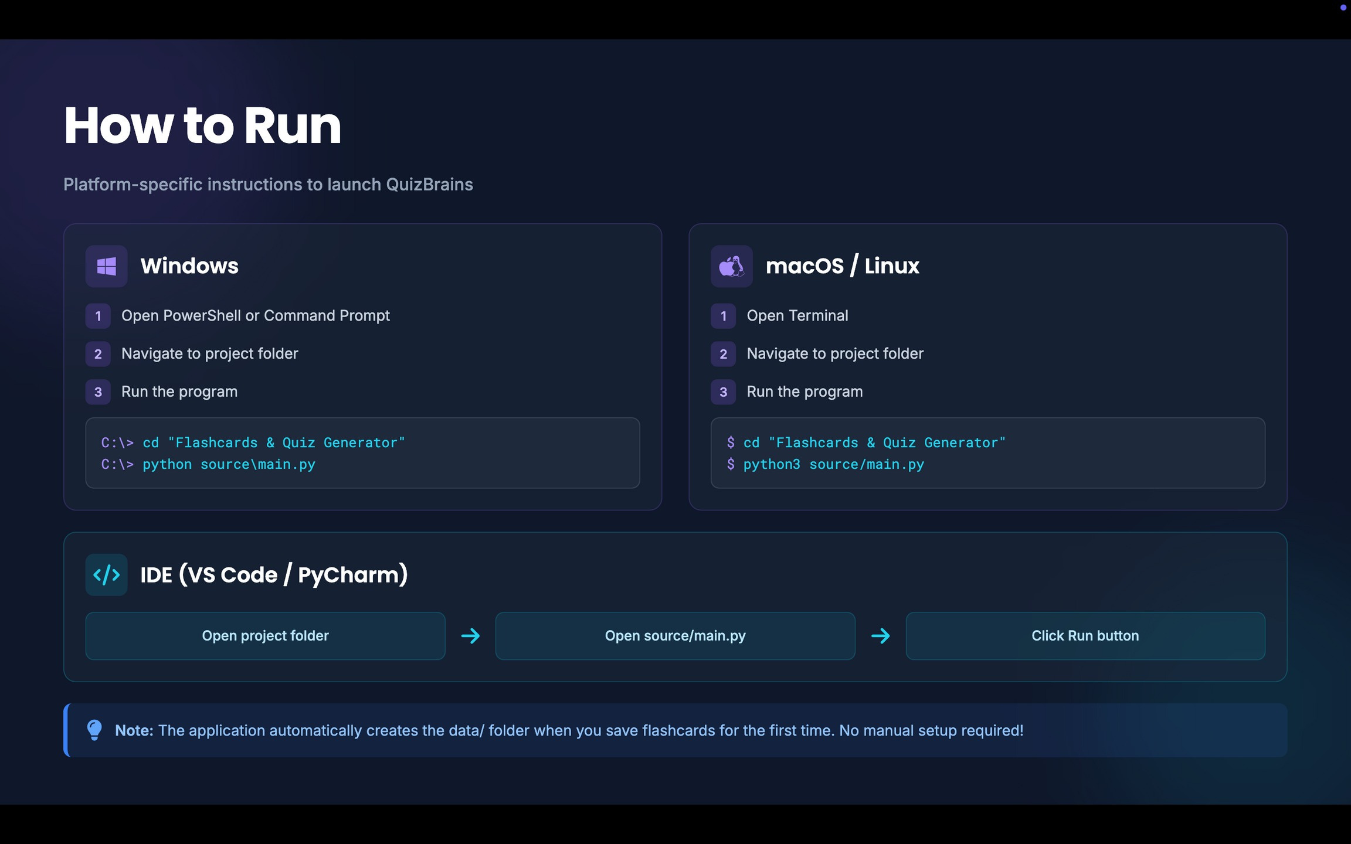

How to Run
Note: The application automatically creates the data/ folder when you save flashcards for the first time. No manual setup required!

Slide 8

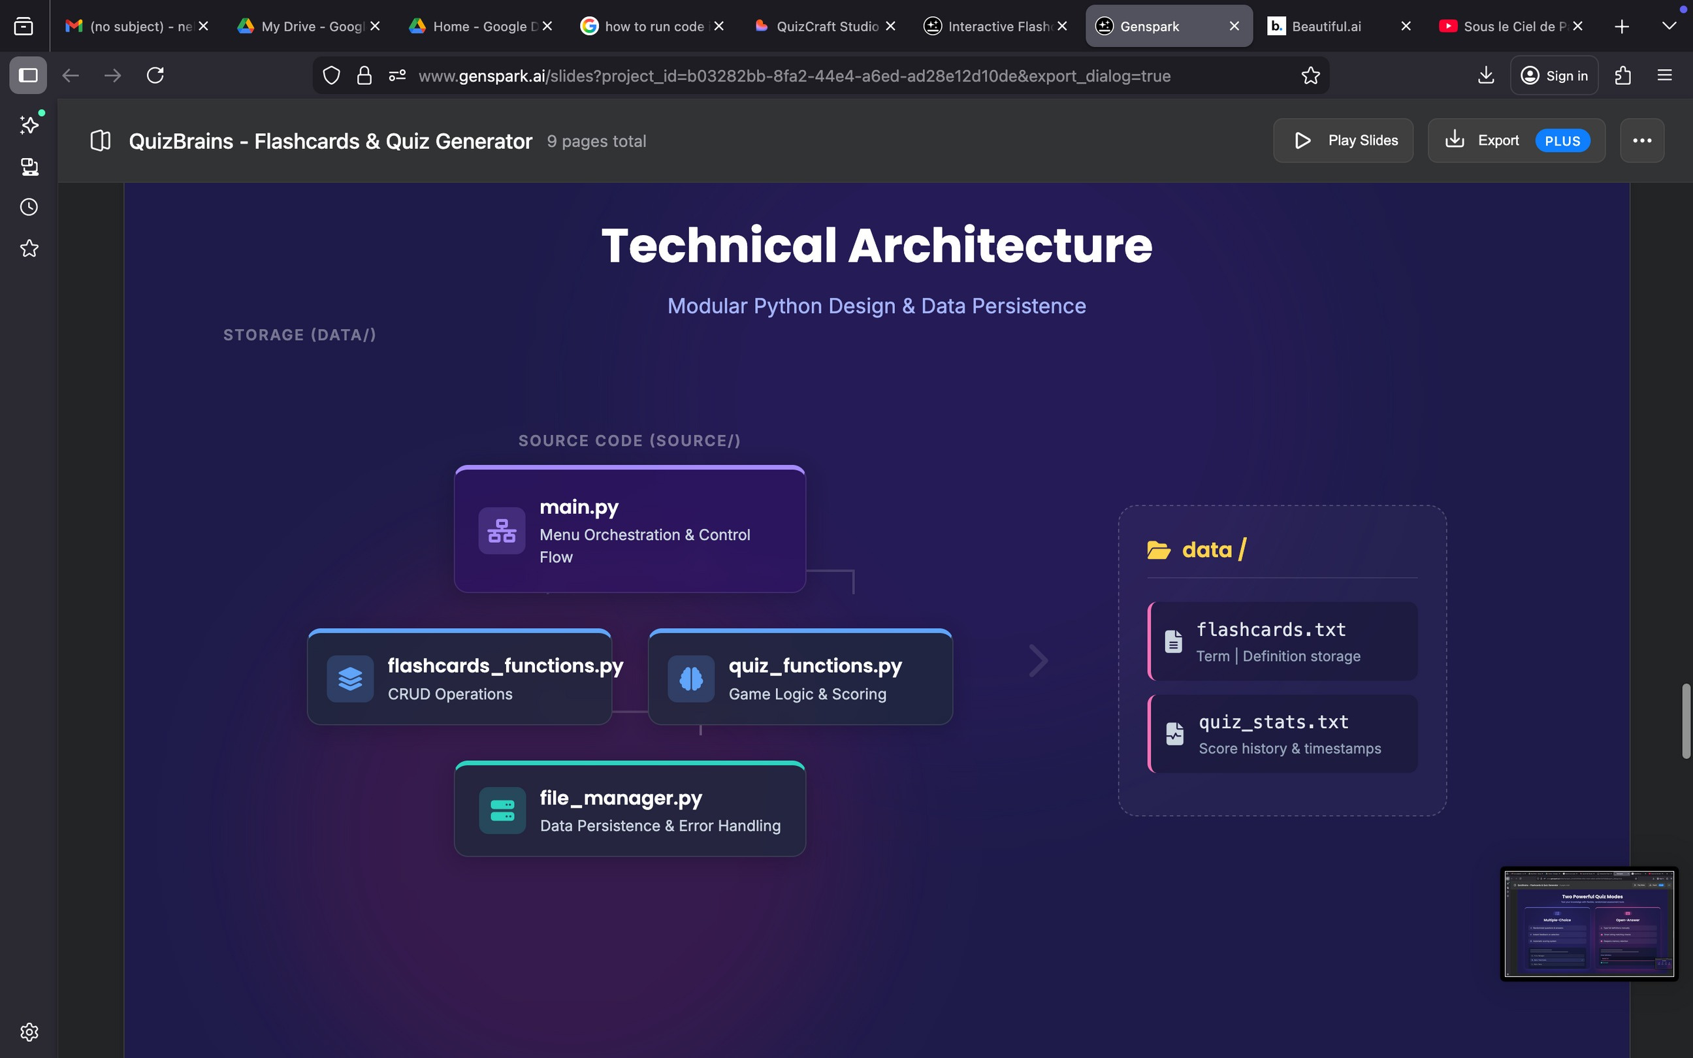
STRUCTURE

Slide 9

Quiz
Quiz modes with randomization, scoring and validation.
quiz_multiple_choice(flashcards)
quiz_multiple_choice(flashcards)quiz_open_ans
wer(flashcards)
def quiz_multiple_choice(flashcards):
questions = list(flashcards.keys()) rn.shuffle(questions)
def quiz_open_answer(flashcards): correct_answer = flashcards[q].strip().lower() user_answer = input().strip().lower()
#Build randomized choices
Purpose:
PURPOSE:
User types the full definition for each
flashcard term. Performs case-insensitive
comparision, provides instant feedback and
calculates final score.
Generates a multiple-choice quiz randomized
questions and answer options. Validates
numeric input, scores answers and provides
immediate feedback.
Quiz Features: Questions randomized every time
Multiple-choice options shuffled Wrong answers sampled from other flashcards Both modes call save_quiz_result(score, total) Emoji feedback for correct answers.

Slide 10


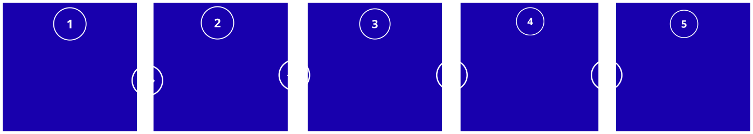

User Navigation
How to use QuizBrainsandnavigate the codebase.
User Workflow
Review Progress
Launch App
Build Deck
Quiz yourself
Save & Exit
Run main.py, see menu
Add, edit,list, delete
Multiple choice or open
Check quiz history
All changes saved
Code Navigation Path
main.py Start here
flashcard_function.py
quiz_functions.py file_manager.py
CRUD operations
Quiz logic
I/O & Persistance
Developer Tip: Start by reading main.py to understabd the menu flow, then explore each module to see how functions are implemented. Each module has clear docstrings explaining its purpose.

Slide 11

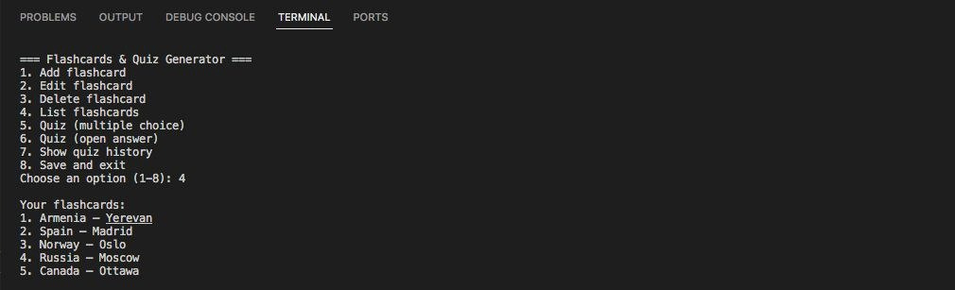
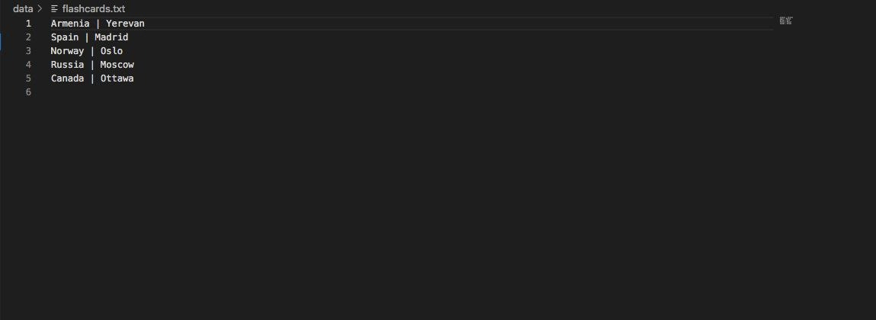
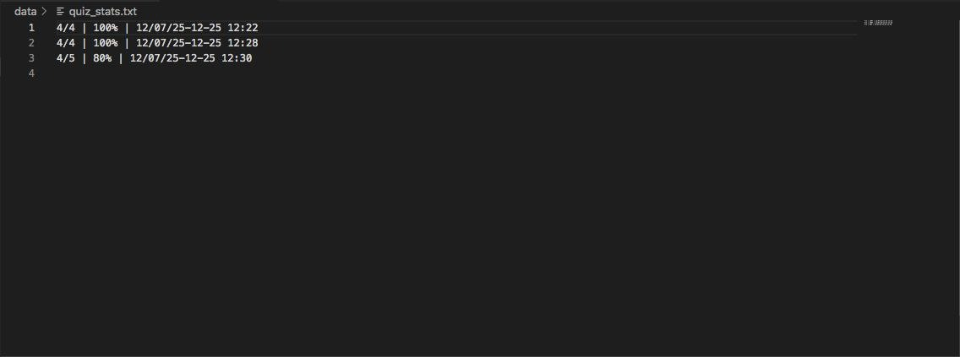
Outputs Examples

Slide 12
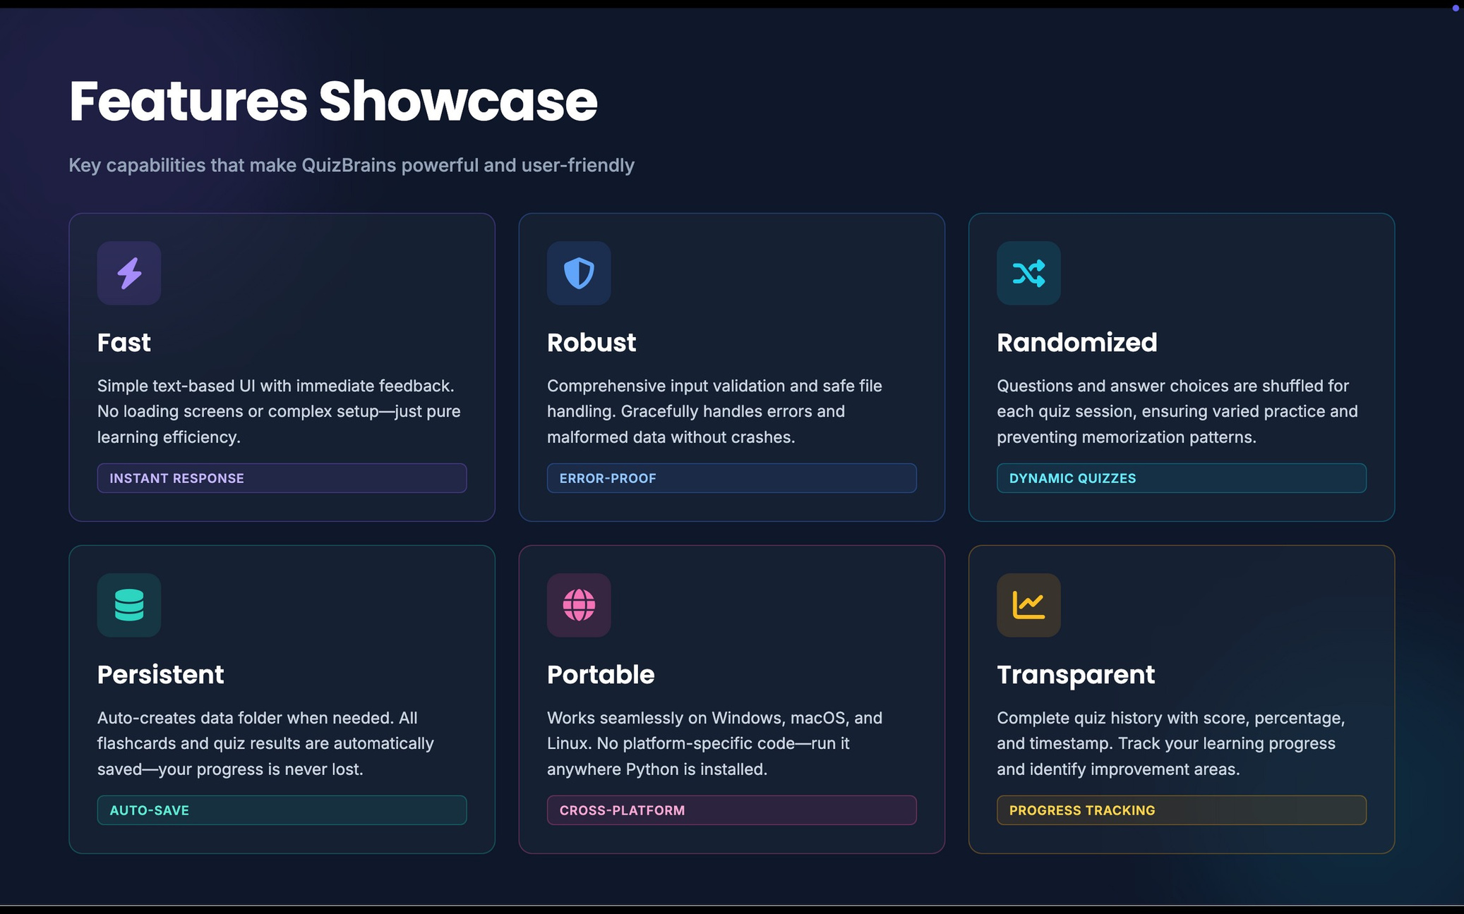
Features Showcase
Key capabilities that make QuizBrains powerful and user-friendly

Slide 13


THANK YOU!
Thank you for exploring QuizBrains. We hope this project inspires effective learning!
Nelli Poghosyan
Mane Karapetyan
Rozeta Gevorgyan
QuizBrains

